Slide 1

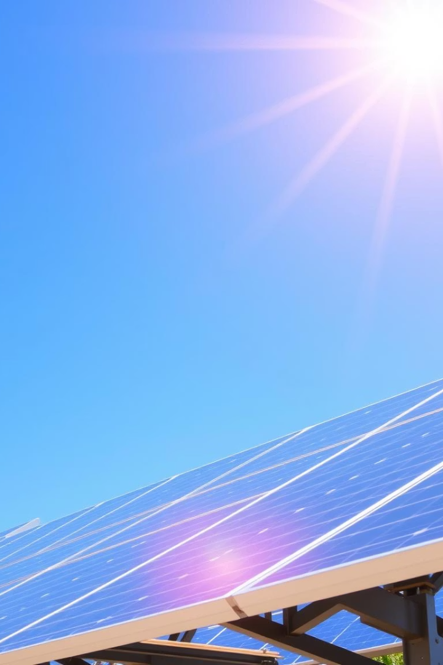

SolarGuard
Intelligent Solar Panel Defect Detection Using Deep Learning
Author: Sham Prasath K
by Sham Prasath K

Slide 2
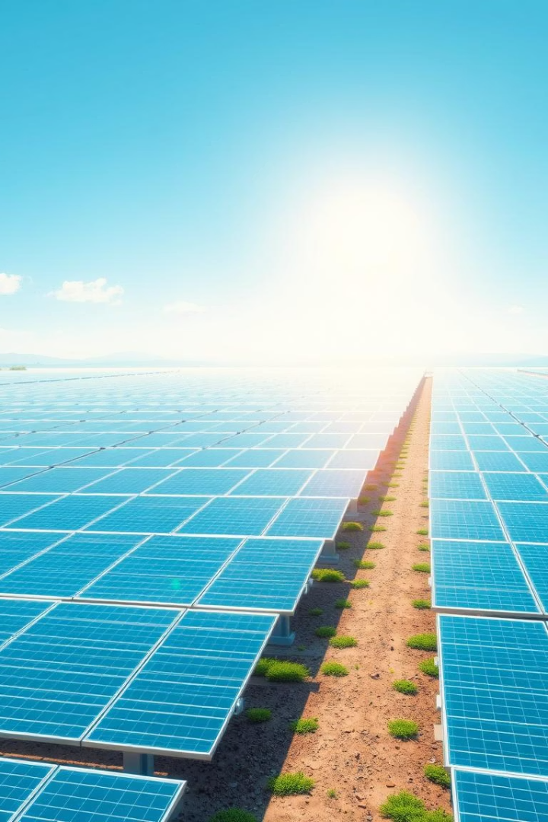
Introduction: The Rise of Solar Energy
Rapid Growth
Market Potential
Solar capacity grew 22%
Global solar market reaching $223.3B by 2031.
Need for Efficiency
Efficient defect detection maximizes ROI and output.

Slide 3
The Challenge: Defect Detection
Traditional Methods
Defect Impact
Common Defects
Manual inspections are slow and inconsistent.
Efficiency losses of up to 30% due to defects.
Microcracks
Hotspots
Potential Induced Degradation (PID)

Slide 4
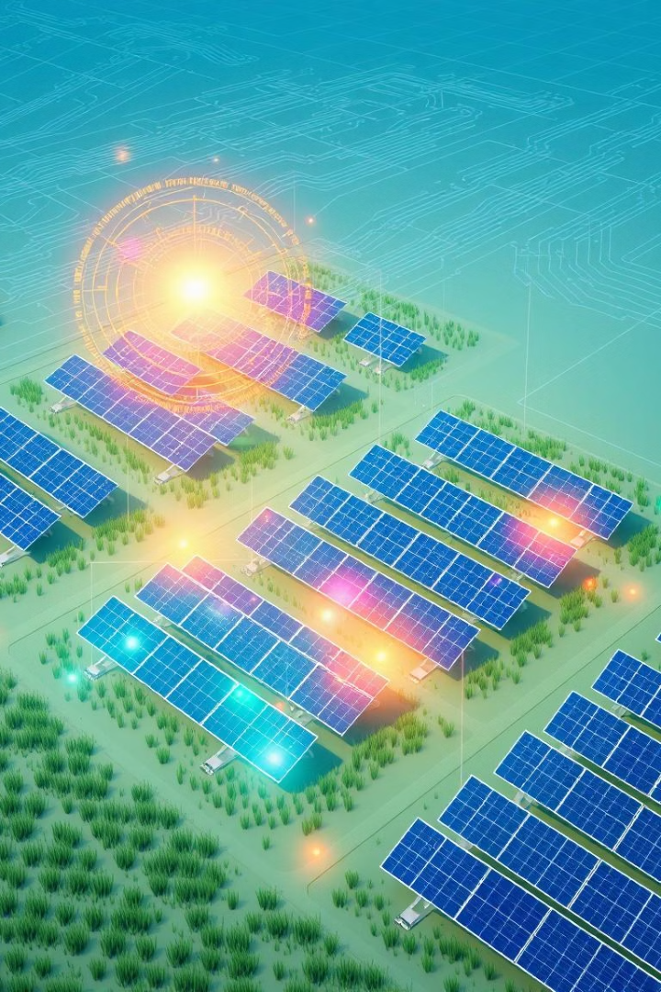

Deep Learning for Defect Detection
Advanced CNN Models
Detection Architectures
Convolutional Neural Networks for image analysis.
Using Faster R-CNN and SSD for precise detection.
High Accuracy
Achieved over 90% accuracy in defect classification.

Slide 5
Training Data and Methodology
Large Dataset
Transfer Learning
Data Augmentation
Cloud Training
10,000+ panel images with and without defects.
Leveraging pre-trained ImageNet models.
Enhanced model robustness via image transformations.
48-hour AWS cloud-based model training process.

Slide 6





SolarGuard: Key Features
Real-Time Detection
Automated Reporting
System Integration
Defect capture using drone imagery.
Comprehensive analysis dashboards for insights.
Works seamlessly with existing monitoring tools.
Defect Localization
Pinpoints exact defect locations on panels.

Slide 7
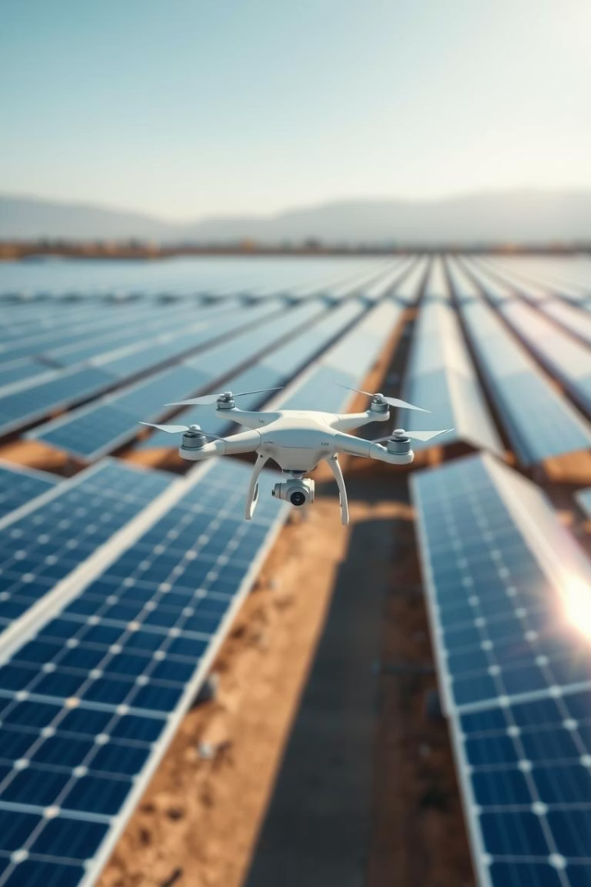
SolarGuard in Action
Case Study
Implemented at a 1MW solar farm in California.
Inspection Speed
Inspection time reduced by 80% with AI.
Defect Detection
Found twice as many defects as manual checks.
Energy Gains
Energy output increased by 5% after repairs.

Slide 8
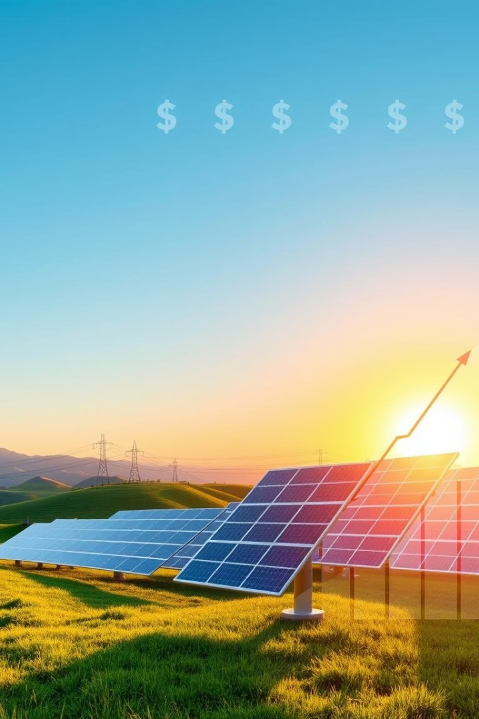
ROI and Benefits
Cost Savings
Energy Increase
Maintenance costs cut by 40% with automation.
Boosts production and revenue from panels.
Improved Reliability
Extends panel lifespan through timely repairs.

Slide 9
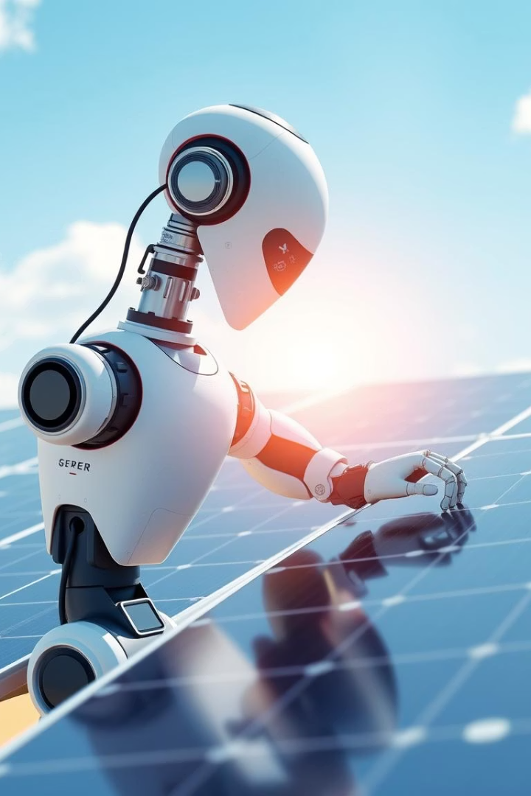




Future Enhancements
Predictive Maintenance
Machine learning forecasts defect development.
Cloud Processing
Scale storage and computation with the cloud.
Expanded Detection
Broader defect types identified automatically.
Robotic Repair
Automated fixes integrated with defect detection.

Slide 10
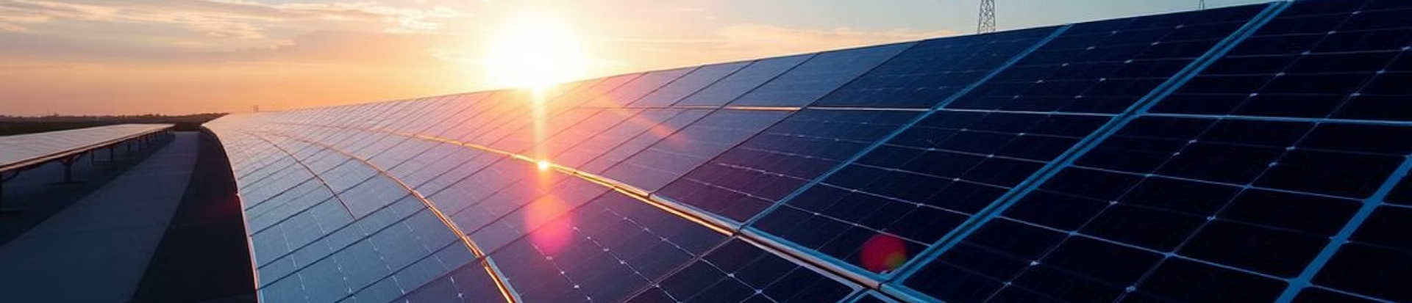
Conclusion: The Future of Solar Inspection
SolarGuard Innovation
Industry Impact
Energy Maximization
Efficient, intelligent, and cost-effective defect detection.
Revolutionizes how solar panel defects are found.
Unlocks the full potential of solar energy systems.

